Slide 1
Implementation
Mapping Design to (C#/Java) Code
Notes:
2/6/17 - updated

Slide 2
Overview
At the end of this session, you will be able to:
Explain how the various UML models support software development activities
Map the various design class diagrams into a programming language such as C# or Java
Notes:
2/6/17 - updated

Slide 3
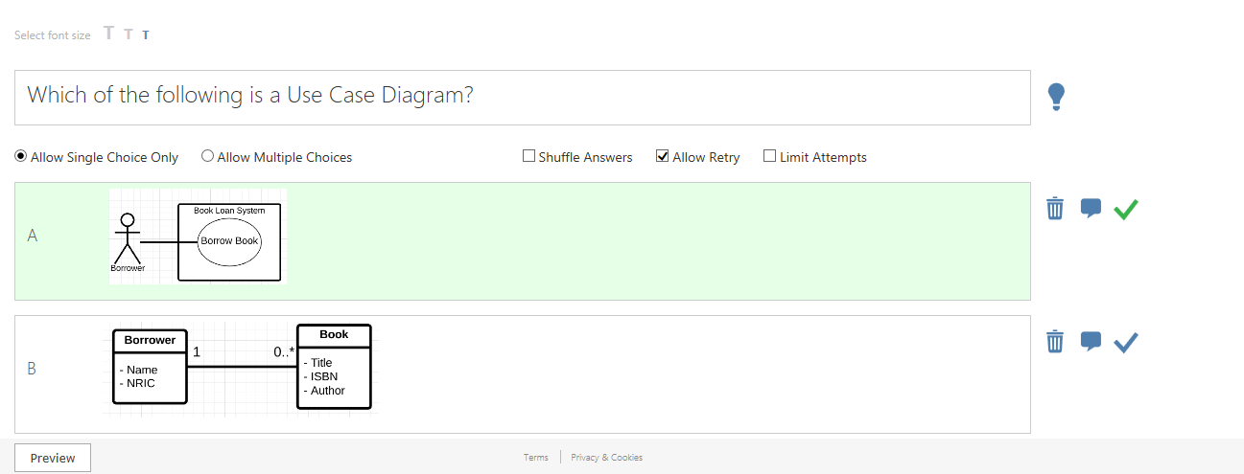
Recap

Slide 4
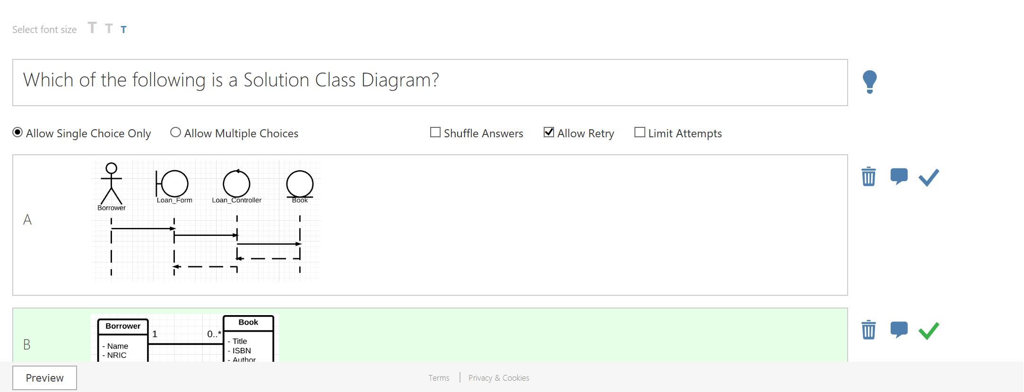
Recap

Slide 5
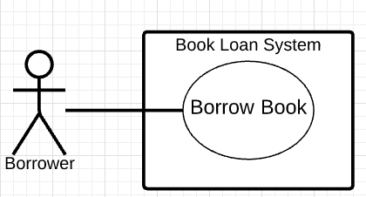
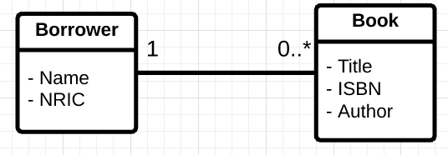
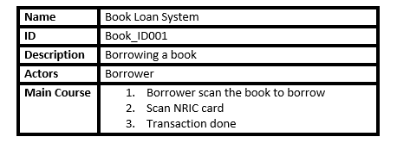
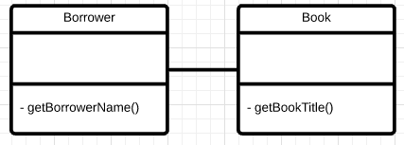
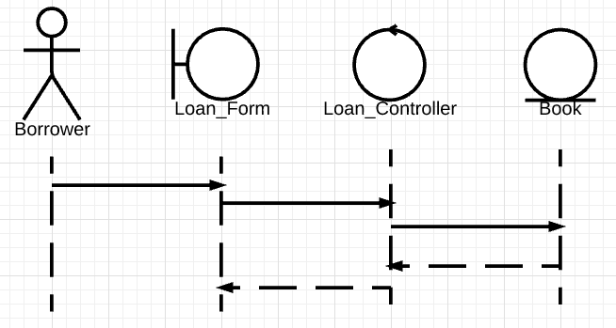
Software Development Steps
Normally, software developers would follow the following key steps:
1. Use Case Diagram & Use Case Description
2. Domain Class Diagram
4. Solution Class Diagram
3. Sequence Diagram

Slide 6
What happen next?
Once the diagrams have been completed, developers will then map the methods in the solution class diagram into programming codes such as C# and Java.
The following slides will introduce you to the key steps to develop the method signature by using some of the patterns that we will normally come across.

Slide 7
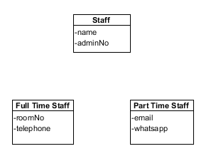
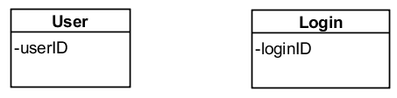
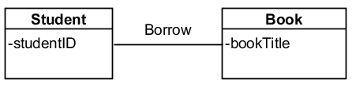
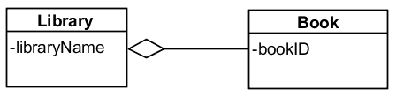
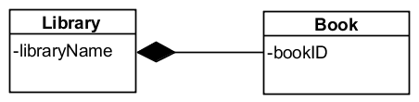
Patterns of relationships between Solution Classes
These are the relationships between each Solution Classes that we will normally come across:
Uni-Directional Association
Inheritance
Bi-Directional Association
Aggregation
Composition
Notes:
2/6/17 - updated

Slide 8


Mapping a solution class to C#
public class BasicAccount {
private string accountNumber;
private double balance;
public double getBalance() {
…
}
public void credit(double amt) {
…
}
public void debit(double amt) {
…
}
}
Notes:
3/6/17 – updated
With animation

Slide 9
Mapping a solution class to Java
public class BasicAccount
{
private String accountNumber;
private double balance;
public void getBalance()
{ … }
public void credit(double amt)
{ … }
public void debit(double amt)
{ … }
}

Slide 10
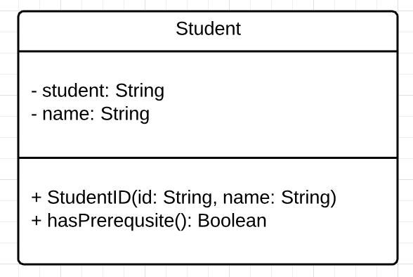
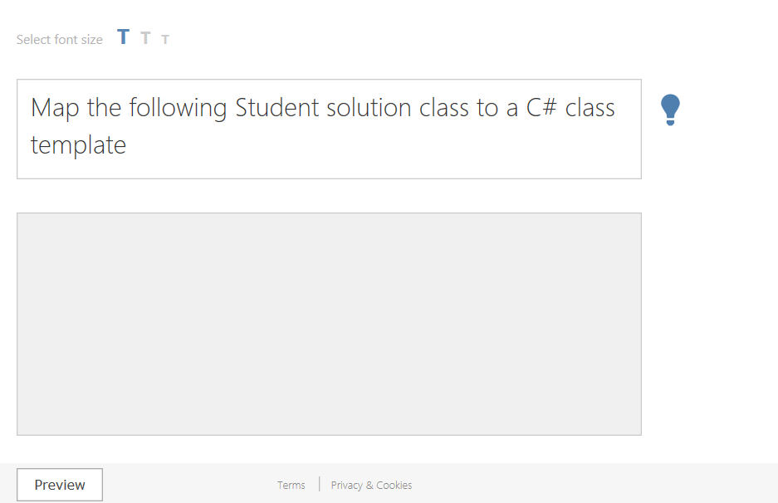
Task 1.0
Notes:
3/6/17 - updated

Slide 11
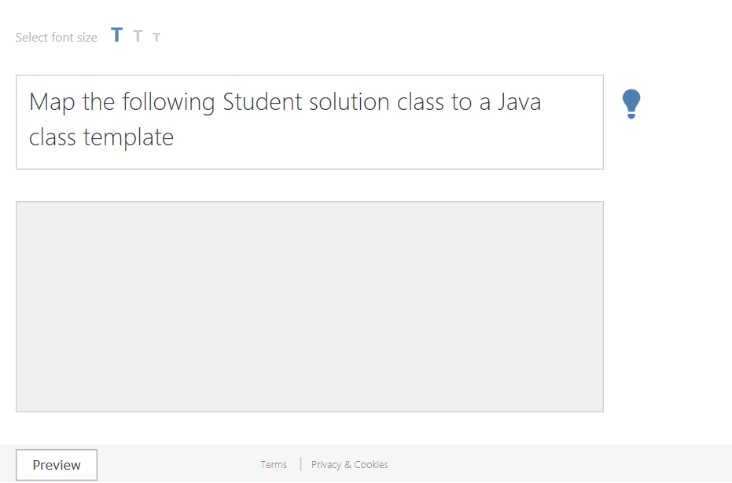
Task 1.1
Notes:
3/6/17 - updated

Slide 12
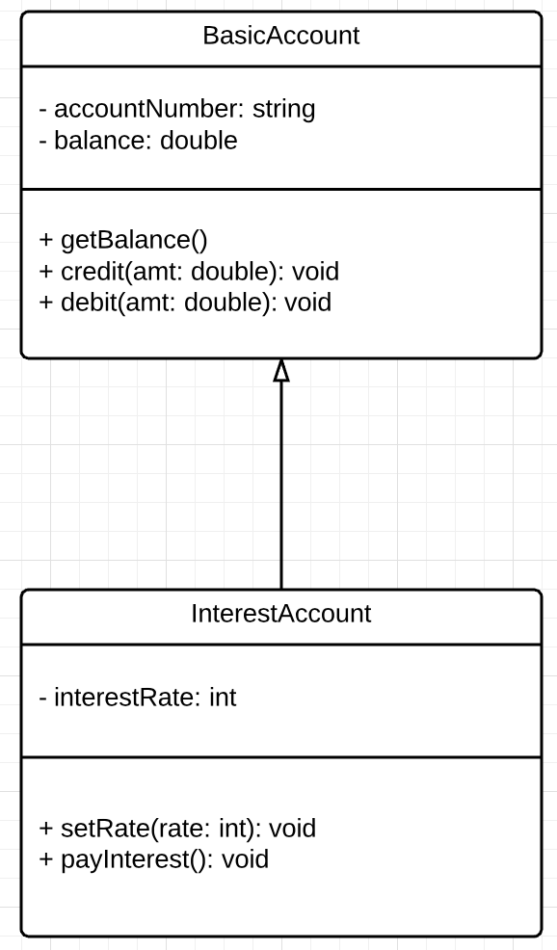
Mapping Inheritance in C#
Public class InterestAccount : BasicAccount
{
private int interestRate;
public void setRate(int rate)
{ … }
public void payInterest()
{ … }
}
In C#, we will use “:” to indicate inheritance relationship between two classes

Slide 13
Mapping Inheritance in Java
Public class InterestAccount extends BasicAccount
{
private int interestRate;
public void setRate(int rate)
{ … }
public void payInterest()
{ … }
}
In Java, we will use “extends” to indicate inheritance relationship between two classes

Slide 14
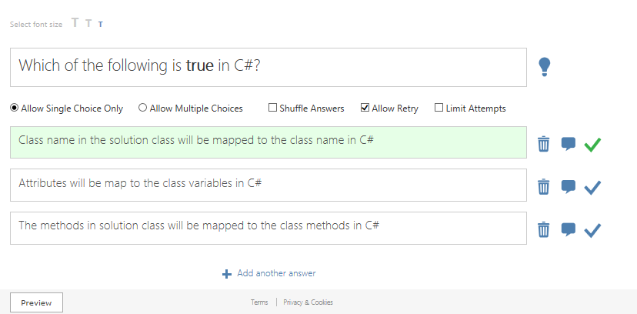
Quiz

Slide 15
Mapping associations
In C#, association in a solution class diagrams can be viewed as mapping to solution class relationship.
To handle the relationship between BasicAccount and Transaction, we need a reference to a list of Transaction declared in BasicAccount.
We will use Array Type in C# or ArrayList in Java.

Slide 16
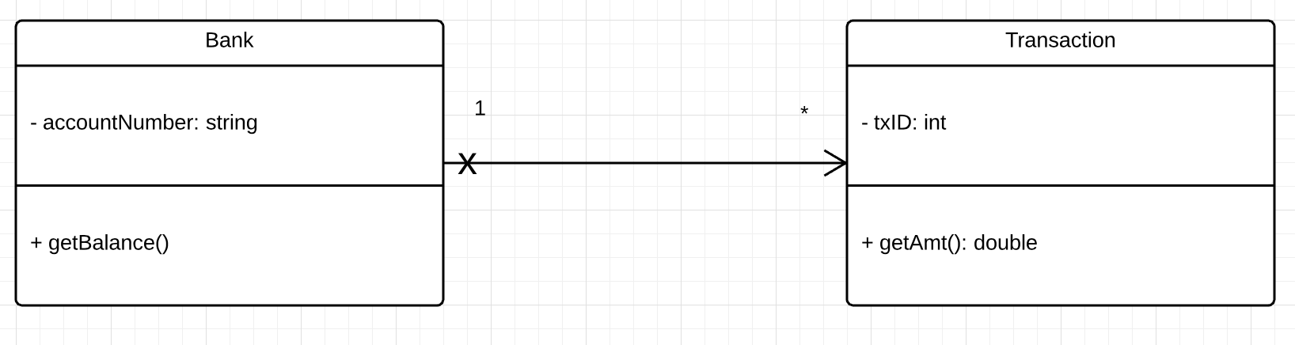
Mapping Uni-directional (one to many) association (C#)
public class Bank
{
private string accountNumber;
private Transaction [] txList;
public double getBalance()
{ … }
}

Slide 17
Mapping Uni-directional (one to many) association (Java)
public class Bank
{
private string accountNumber;
private ArrayList<Transaction> [] txList;
public double getBalance()
{ … }
}

Slide 18
Mapping Bi-directional (one to many) association (C#)
public class Transaction
{
private int txID;
…
private Bank Bnk;
}
public class Bank
{
private string accountNumber;
private Transaction [] txList;
…
}

Slide 19
Mapping Bi-directional (one to many) association (Java)
public class Transaction
{
private int txID;
…
private Bank Bnk;
}
public class Bank
{
private string accountNumber;
private ArrayList<Transaction> txList;
…
}

Slide 20
Task 2.0 – Construct a class diagram
Java code:
public class Module
{
private String moduleCode;
private Lecturertutor;
public boolean computeGrade() { … }
…
}
public class Lecturer extends Staff
{
private ArrayList <Module> modList;
}

Slide 21
Task 2.1 – Construct a class diagram
C# code:
public class Lecturer : Staff
{
private Module [ ] moduList;
….
}
public class Module
{
private string moduleCode;
private Lecturer tutor;
public boolean computeGrade() {… }
….
}

Slide 22

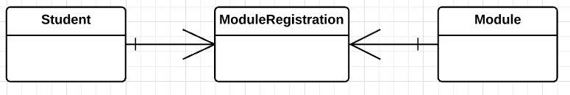
Many to Many association relationship
As for many-to-many association relationship, we cannot map the design directly.
We will need to transform the many to many relationship to two 1 to many relationships.
In the context of the database, ModuleRegistration is known as an association or an intersection table

Slide 23
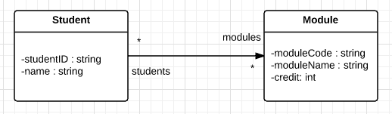
Association Class
Association class is rendered by a dashed line from the association to the class rectangle.
Association class is essentially a class attached to an association; the association itself is modelled as a class.

Slide 24
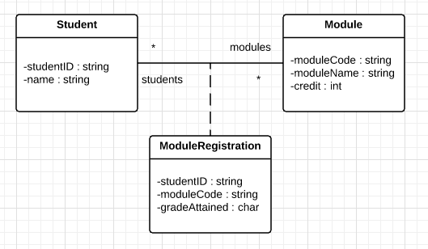
Association class
A student can study many modules and a module can be studied by many students.
We can model the association as an association class and put that information in the association class as shown below:
Association class

Slide 25
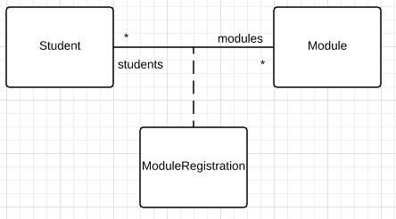

Implementation of association class
There are several ways to implement an association class.
The easy way is to change the many-to-many association and the association class to two unidirectional 1-to-many and many-to-1 associations as shown below:

Slide 26
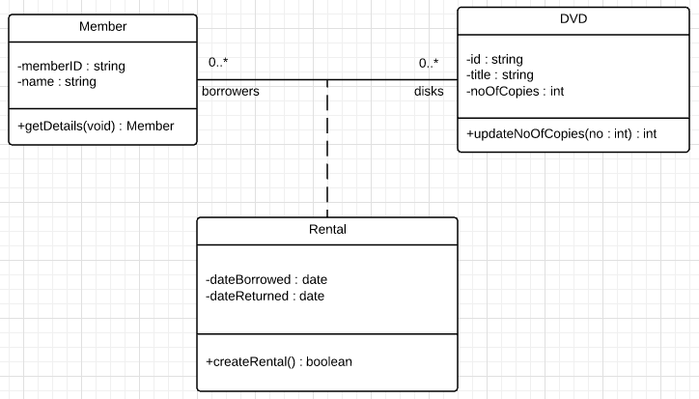

Task 3: Map the design into a corresponding C#/Java class templates

Slide 27
Conclusion
In this SDL, you have learnt:
How to map a solution class to C#/Java class template
How to construct a class diagram, given the relevant code
How to map the design solution class diagram into a corresponding C#/Java class template
Various UML models such as Use Case Model, Domain Model, Sequence Diagram and Design Model

